Slide 1
Global Agricultural Production and Population Analysis
Project 1
Corey Holton, Elena Gehle, Domenic Guerrer, and Roberta Chandler

Slide 2
Overview
Introduction
Background: This project analyzes global agricultural production relative to population data over time. It uses Python to process data on agricultural production by category, and country, as well as global and continental population data. The goal is to visualize trends and relationships between food production and population growth.
Purpose: Explain the significance of understanding the relationship between agricultural production and population.
Objective: To analyze how global agricultural production has changed relative to population over time, focusing on key agricultural products.
2. Research Questions
Key Questions:
How has the production of major agricultural products (e.g., meat, vegetables, grains) evolved over time?
How does agricultural production vary across different countries and continents?
What trends can be observed in the relationship between agricultural production and population growth?

Slide 3
An overview of the data collection, cleanup, and exploration processes (5 points).
After deciding on an area of focus a day was spent searching for available dataset for both Agricultural data and World Population data. After we had access to the datasets, we imported them into our notebook and started viewing the data, we quickly realized we had too much data for the agricultural side and were missing many years on the World Population data, so we retrieved another dataset and merged the second with the first to get population by year that matched the Agricultural data set time frame. We dropped a lot of columns that did not pertain to our analysis and did several restructures. Perfomed several merges so we could focus on production by continents as there were too many countries to plot for graphs. We did the same with items by assigning them to categories that we defined. From there we converted the dataset to time series to plot and do statistical analysis.

Slide 4
The approach that your group took in achieving the project goals (5 points).
Our main goal was to stay on task, be diligent and make progress daily until the tasks were finished
Task were outlined in detail so that we knew what had to be done
To answer our questions, we started by preparing the data so that we could do the analysis. Once the datasets were prepared, we started making different graphs based on the questions we had. Some observations aroused our curiosity and led us to do further exploration of the data.
The next goal was to work on the readme file which was assembled in short time
Lastly, we made an outline of the presentation and added necessary graphs so that would help guide us to complete this portion of the task

Slide 5
Analysis and Conclusion
Findings are strongly supported with numbers and visualizations (10 points).
Write-up summarizes major findings and implications at a professional level (10 points).
Each question in the project proposal is answered with precise descriptions and findings (5 points).
Each question response is supported with a well-discerned statistical analysis from lessons, such as aggregation, correlation, comparison, summary statistics, sentiment analysis, and time series analysis (5 points).

Slide 6
Visualizations
6–8 visualizations of data (at least two per question) (10 points).
Clear and accurate labeling of images (5 points).
Visualizations supported with ample and precise explanation (5 points).

Slide 7
Presentation Requirements
Your presentation should cover the following:
An executive summary or overview of the project and project goals (5 points).
An overview of the data collection, cleanup, and exploration processes (5 points).
The approach that your group took in achieving the project goals (5 points).
Any additional questions that surfaced, what your group might research next if more time was available or share a plan for future development (5 points).
The results and conclusions of the application or analysis (5 points).
Slides effectively demonstrate the project (3 points).
Slides are visually clean and professional (2 points).

Slide 8
How has the production of major agricultural products (e.g., meat, vegetables, grains) evolved over time?

Slide 9
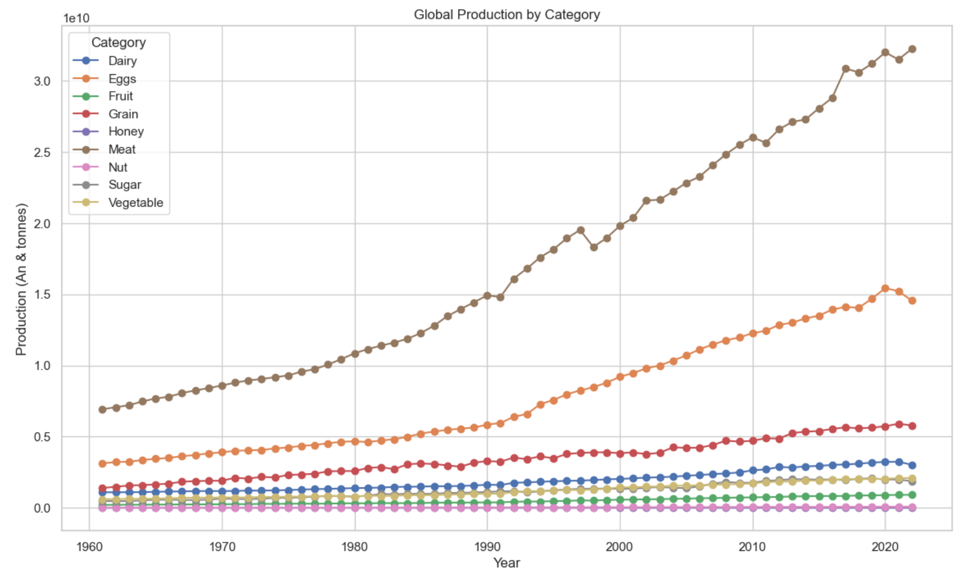

Slide 10
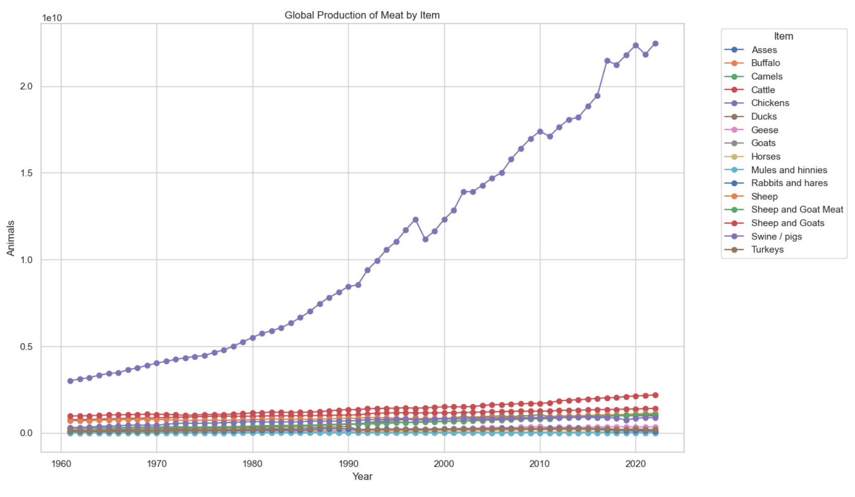

Slide 11
How does agricultural production vary across different countries and continents?

Slide 12
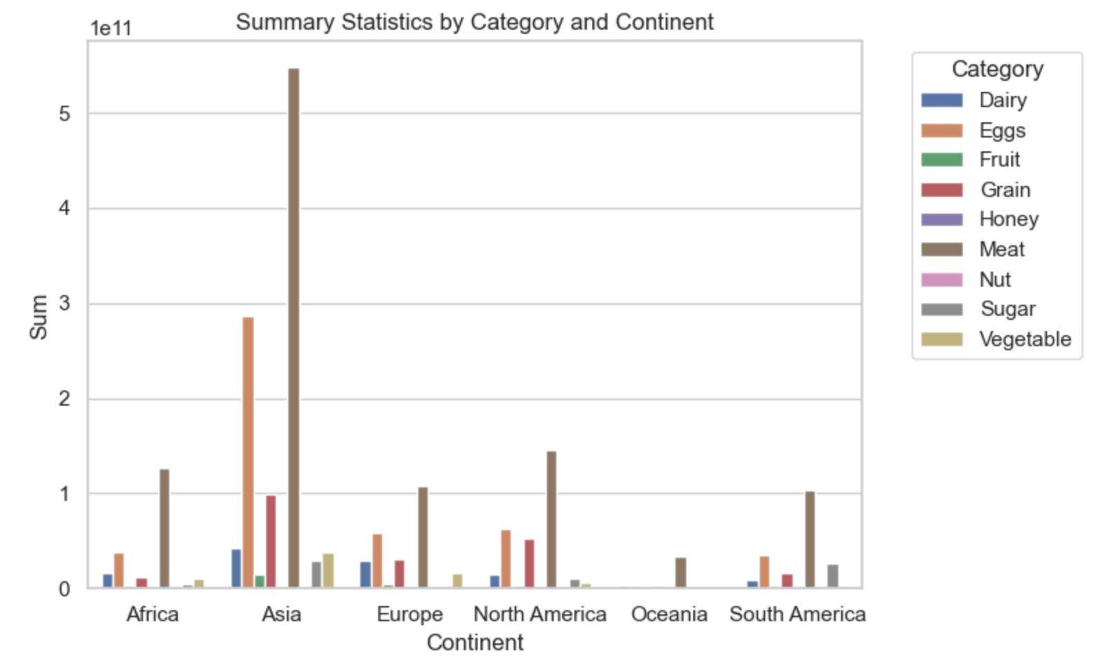
Production of category by continent (sum)

Slide 13
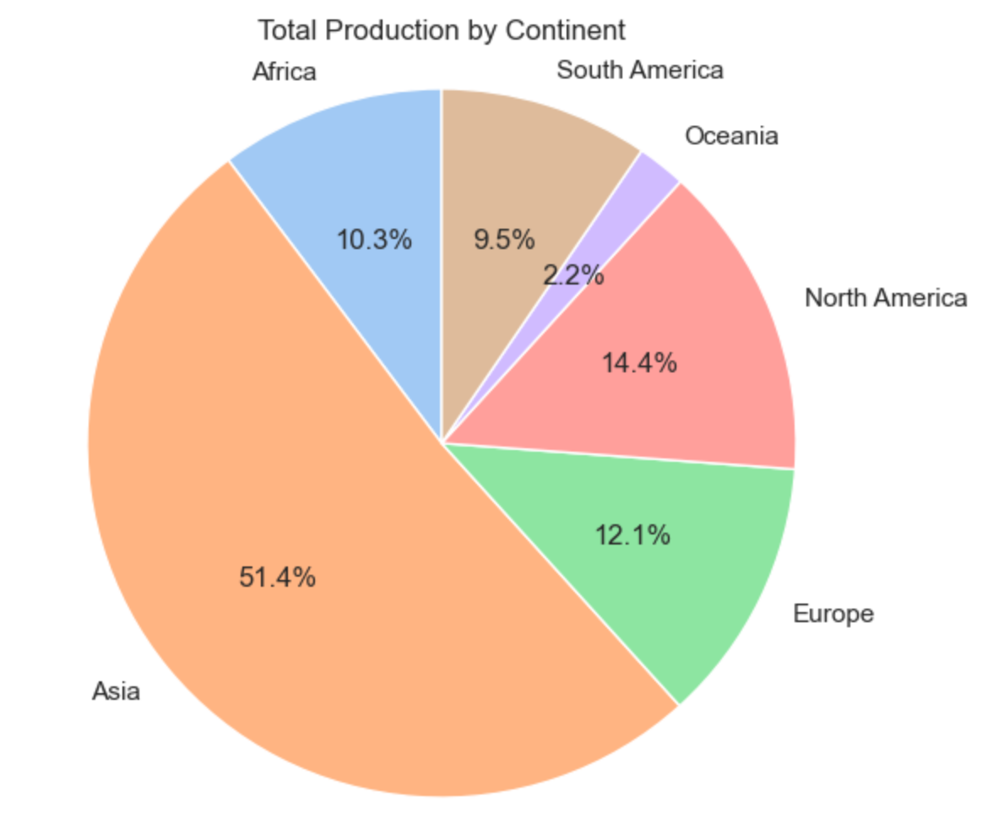
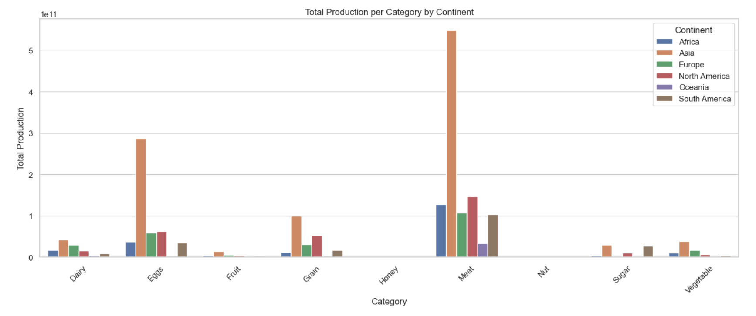
Sum of sums
sum

Slide 14
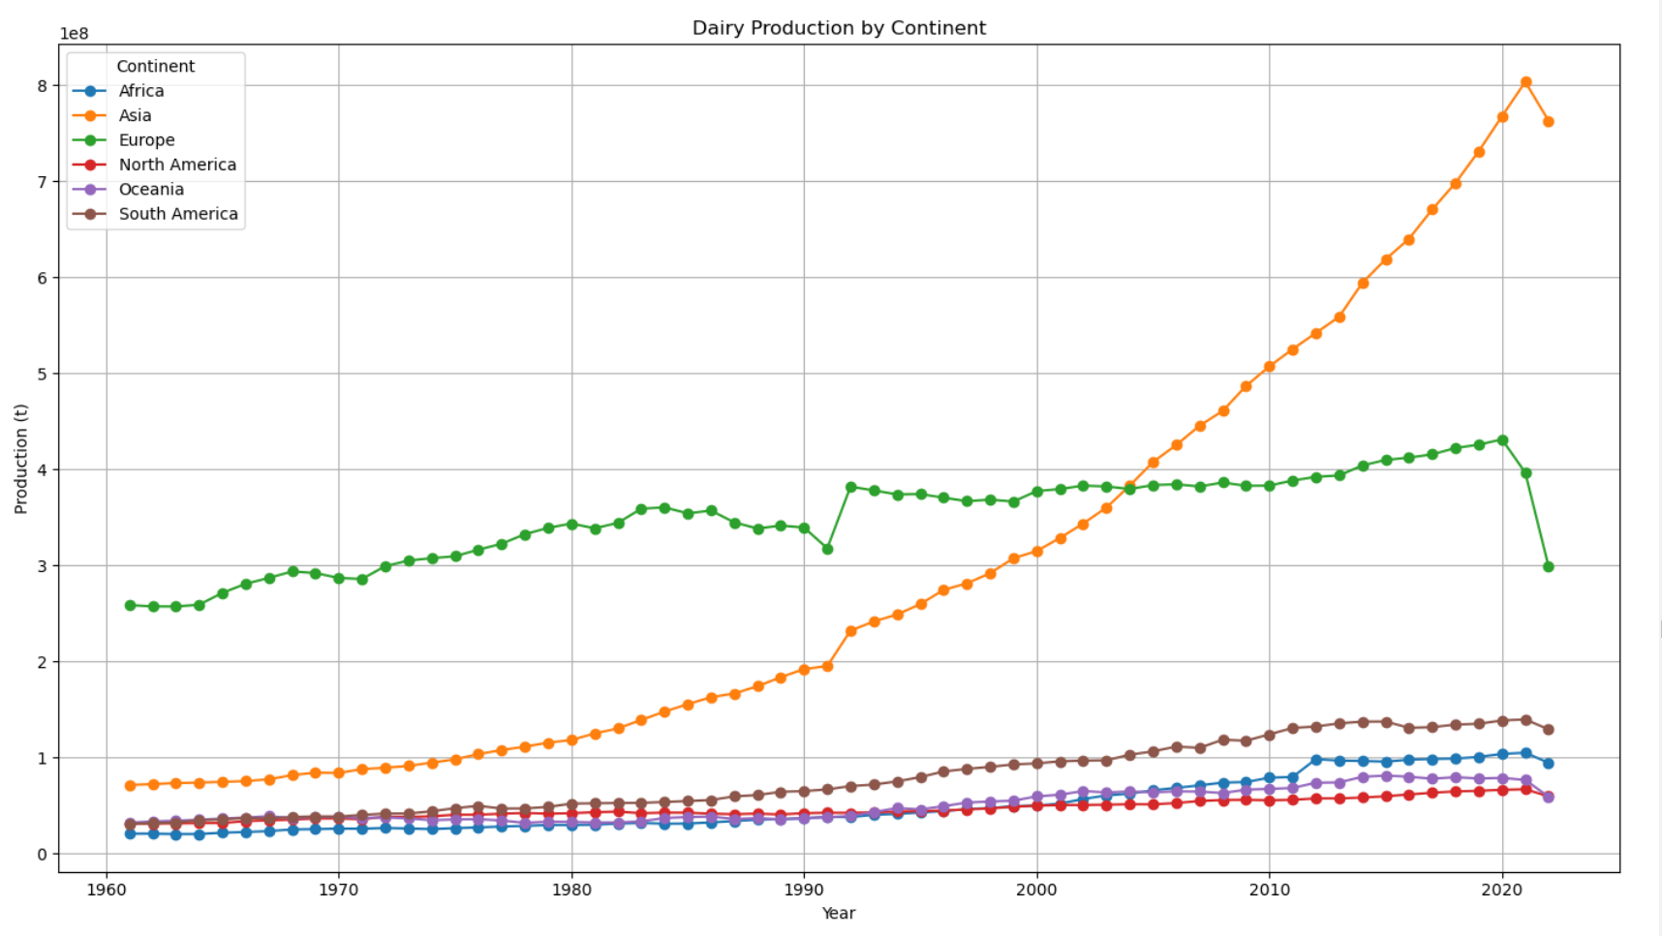
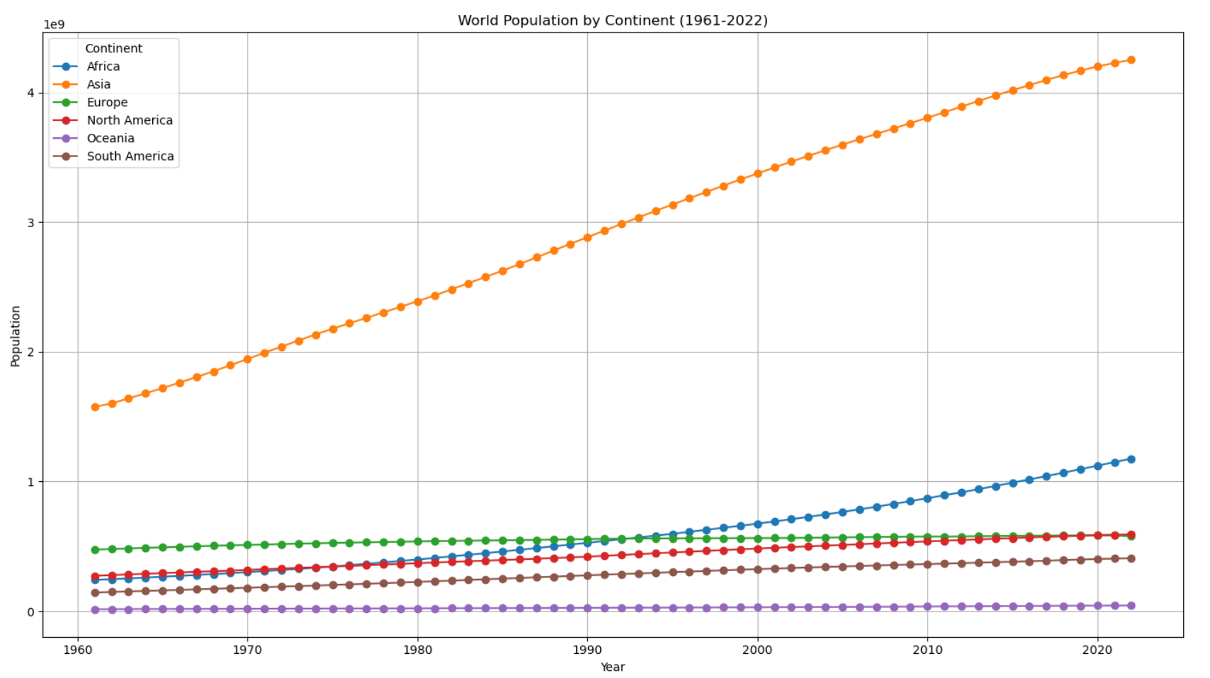

Slide 15
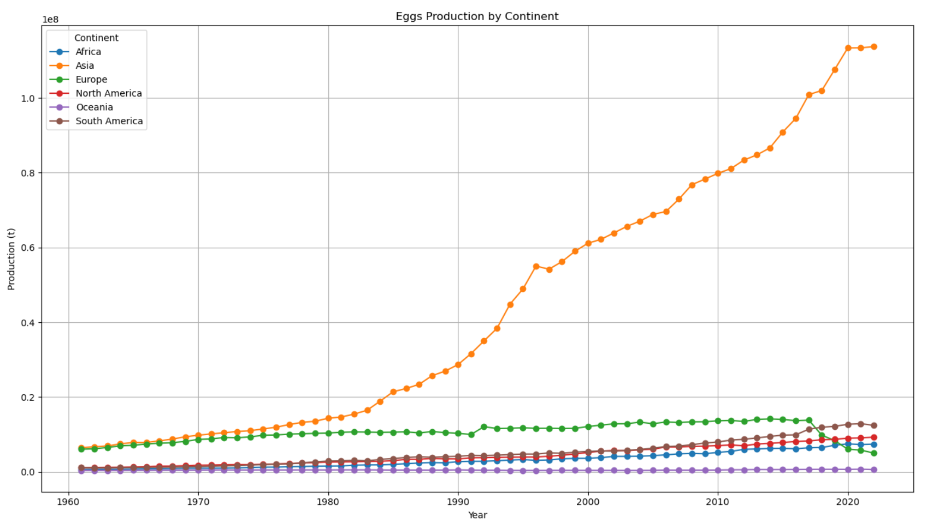

Slide 16
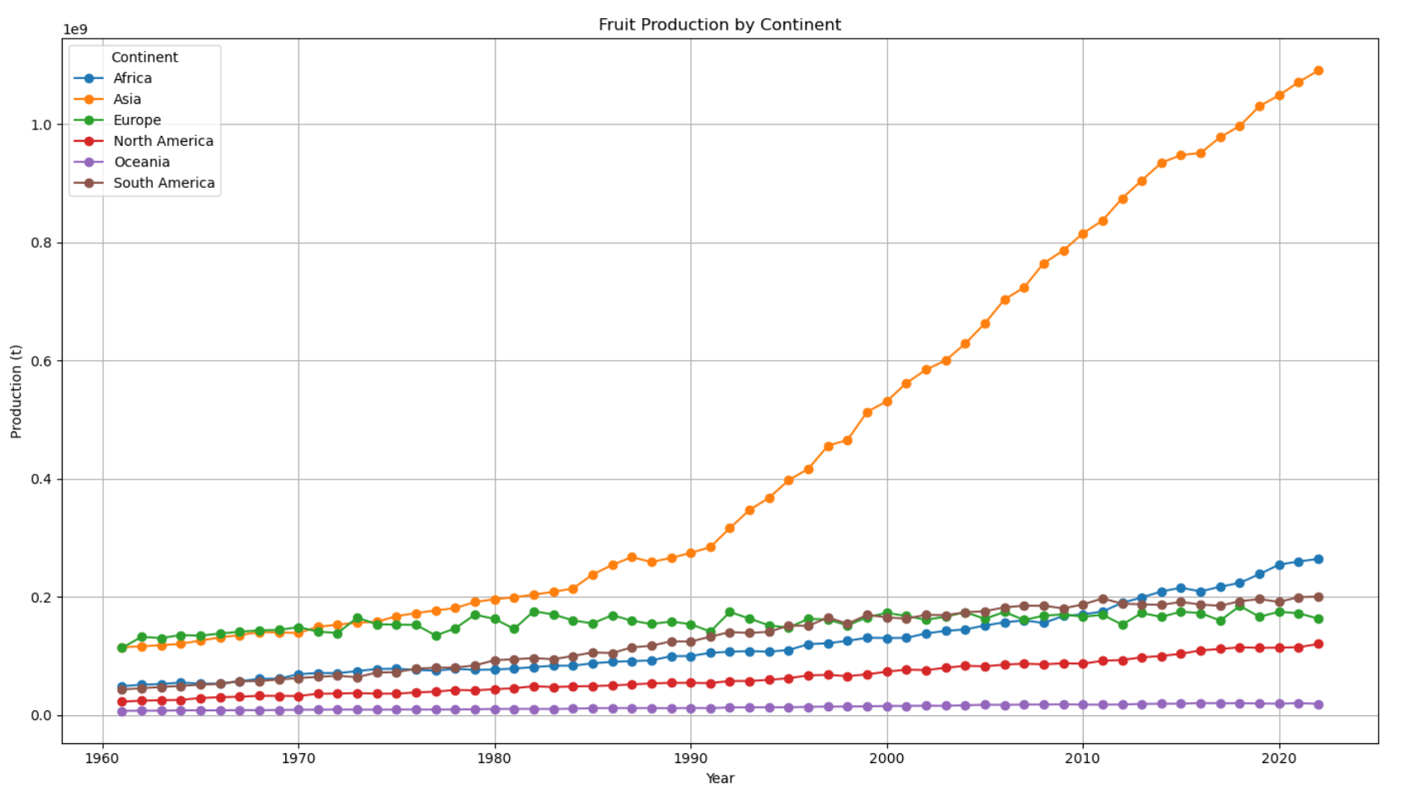

Slide 17
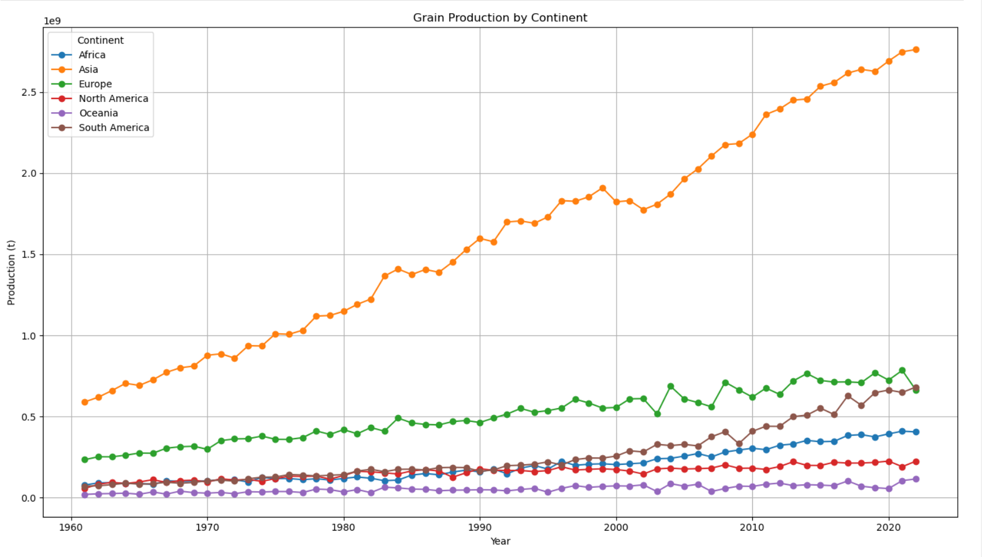

Slide 18
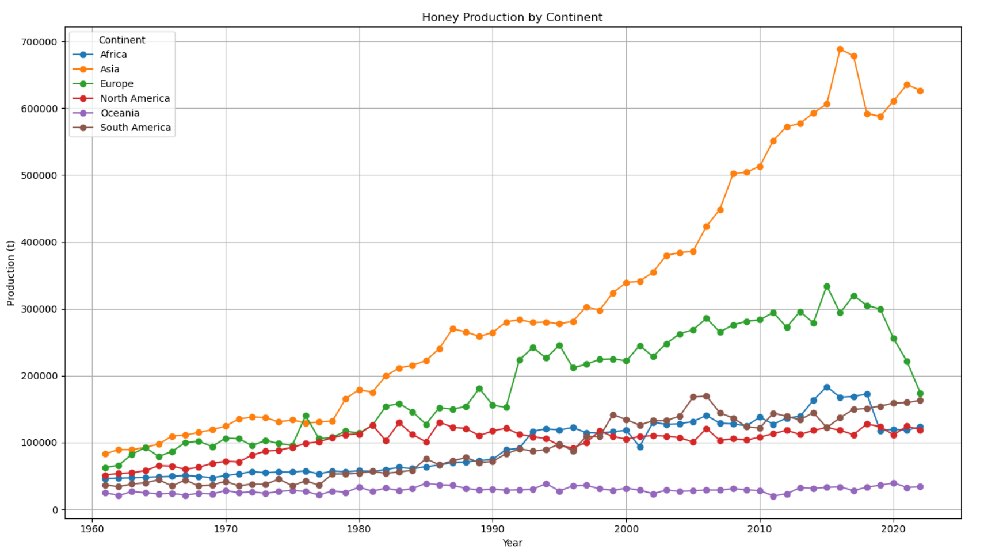

Slide 19
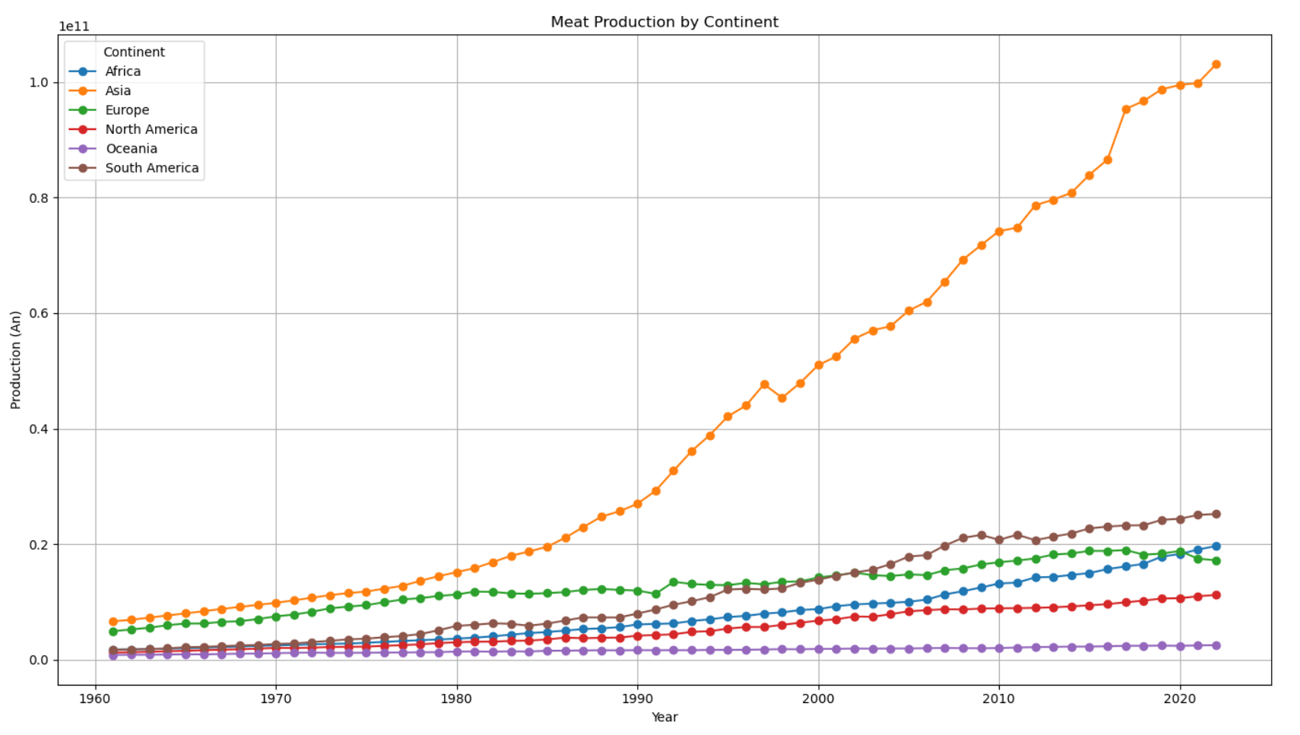

Slide 20
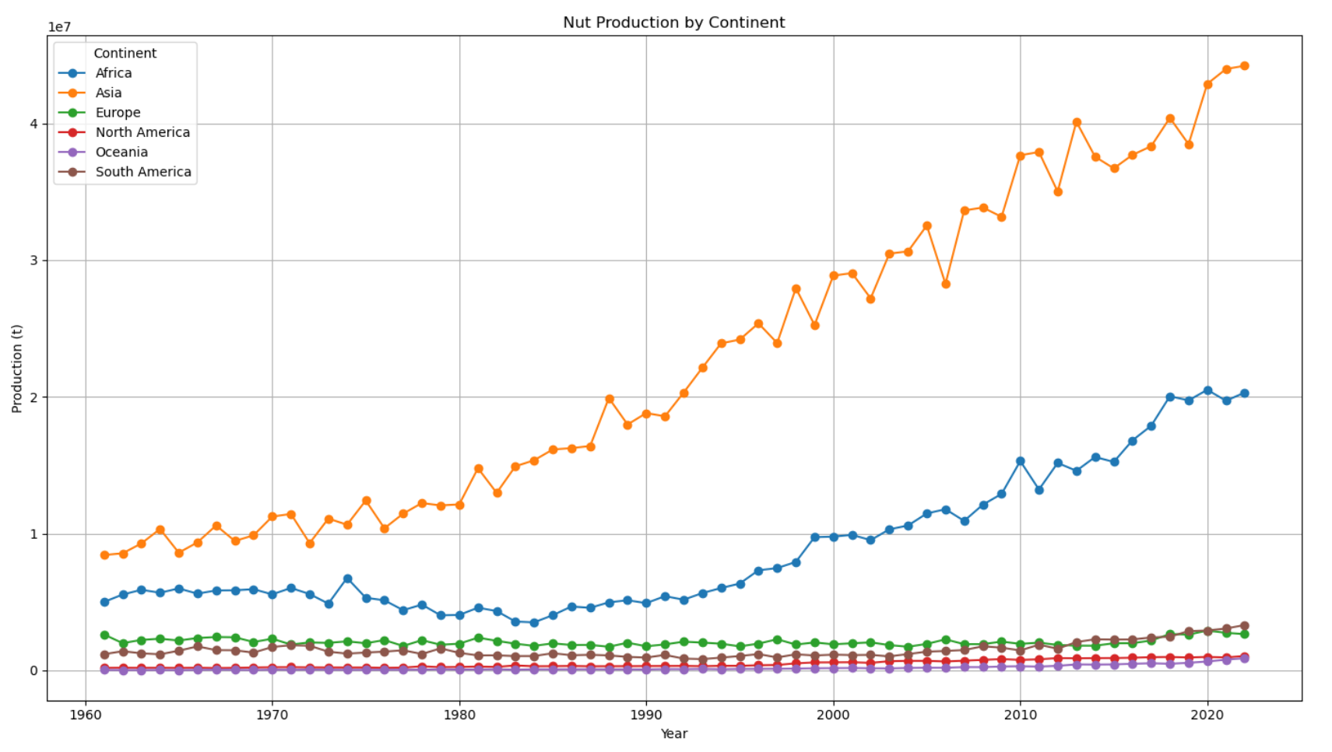

Slide 21
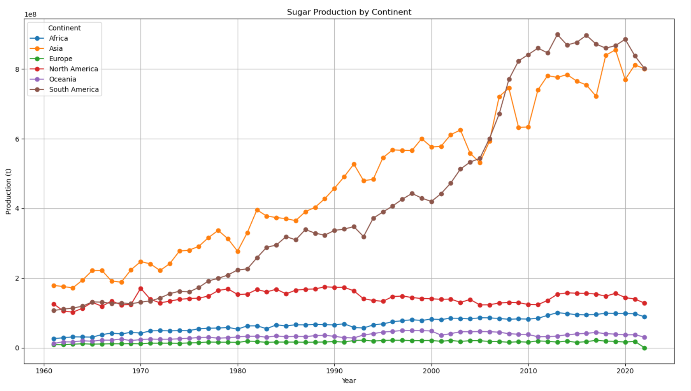

Slide 22
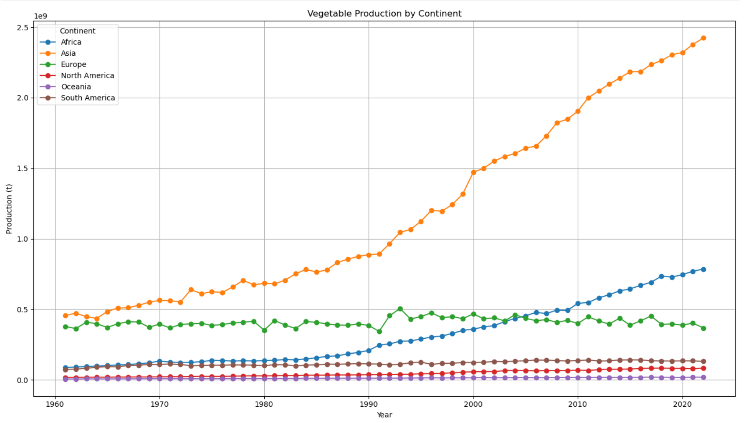

Slide 23
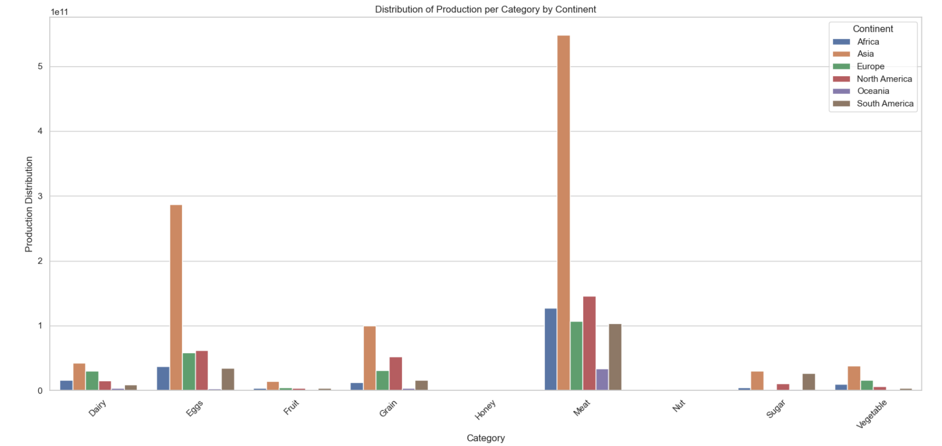
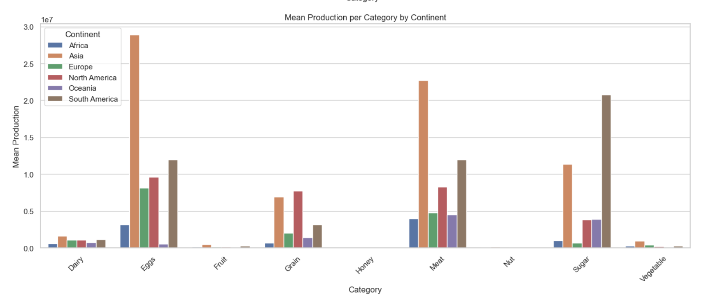
mean
sum

Slide 24
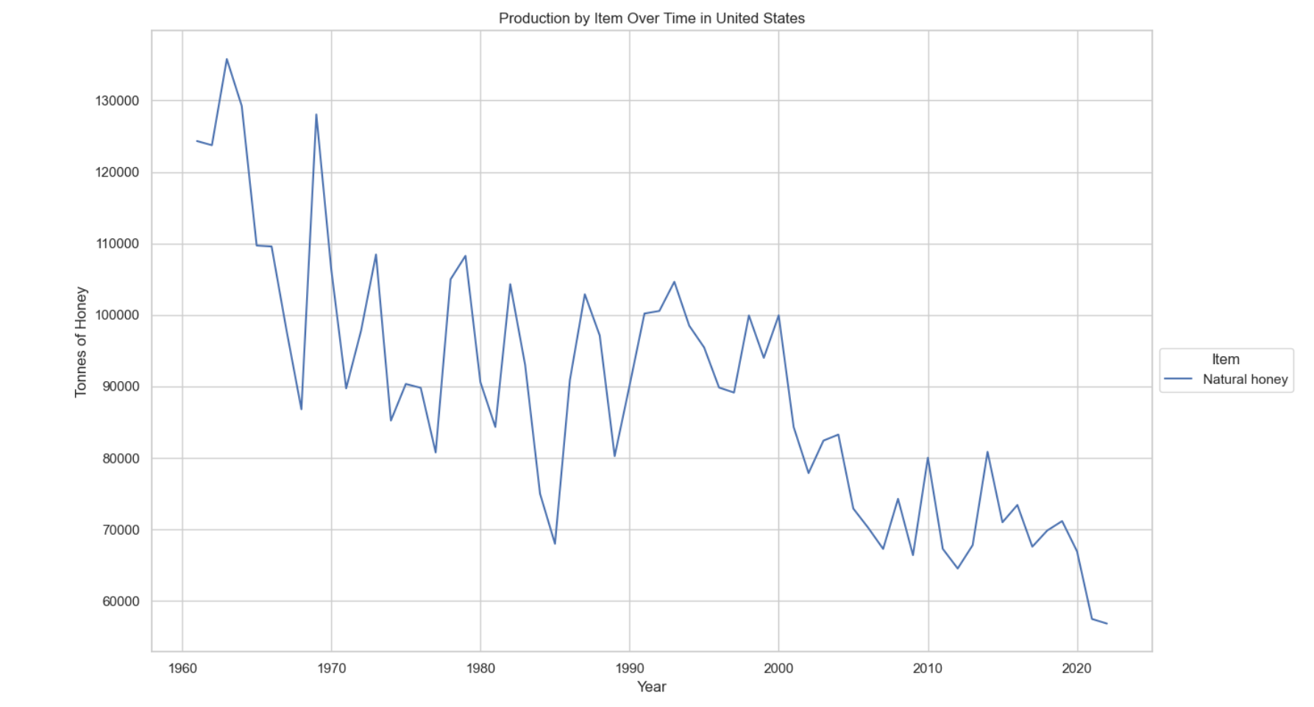
Honey production in the US

Slide 25
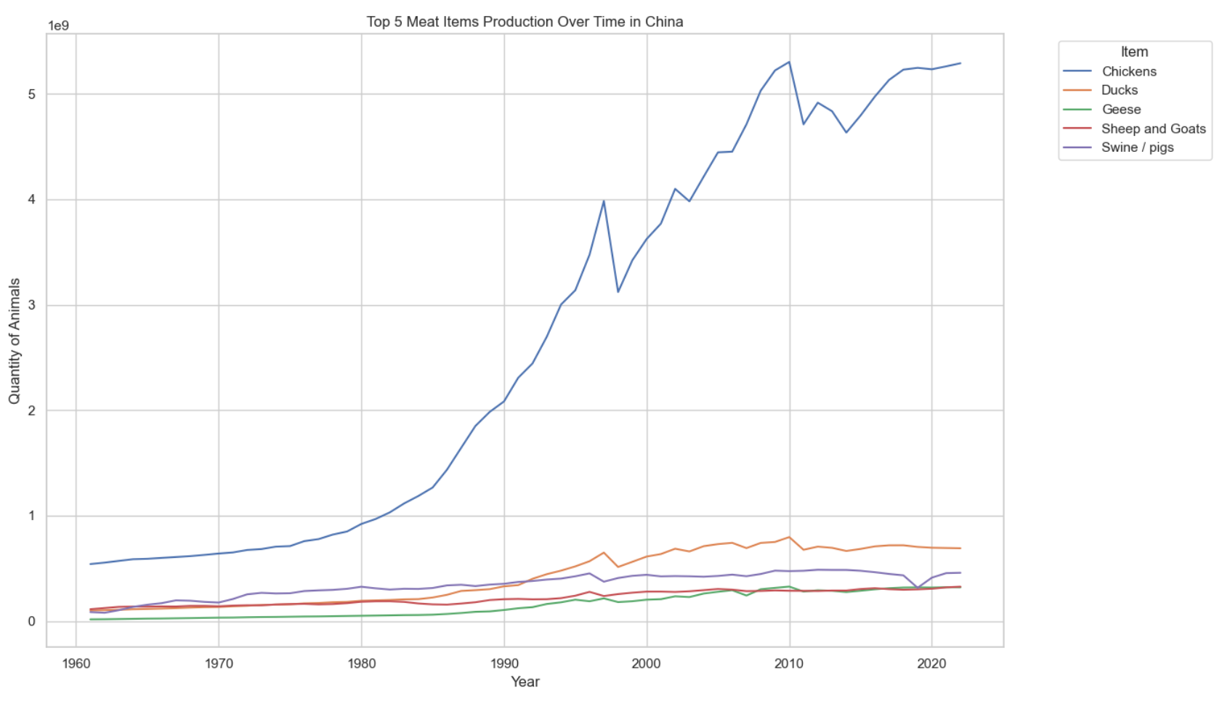
Interesting, chicken is the most produced animal in every continent and almost every country

Slide 26
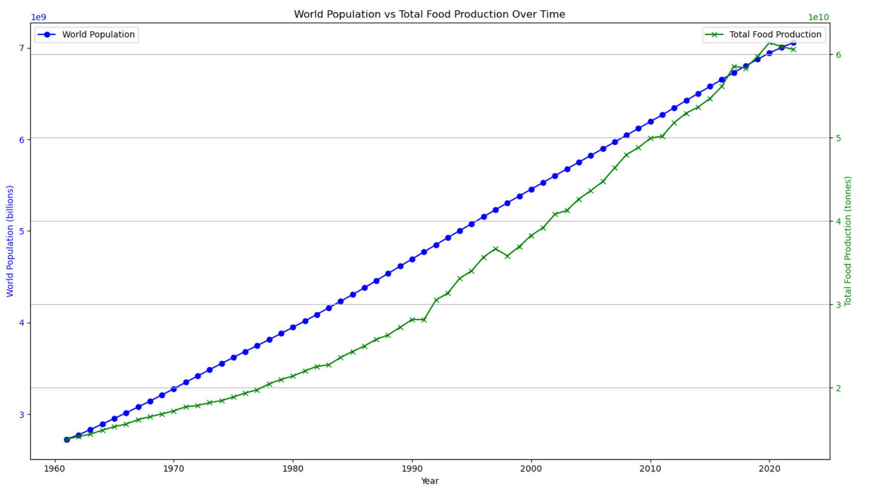
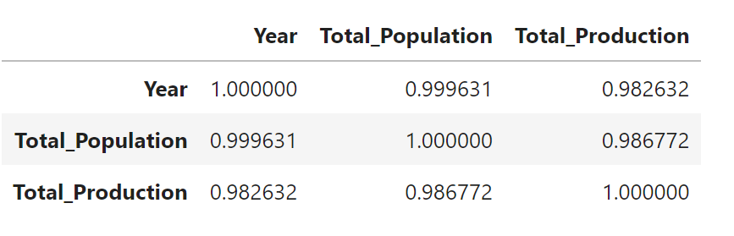
What trends can be observed in the relationship between agricultural production and population growth?
Upon reviewing the data a strong linear relationship was observed in the data between agricultural production and population growth. Population growth from the 1960’s till current has been been at almost a constant growth, this is a bias in our dataset as world population pre-1960 was much flatter and future predictions expect population growth to decline. Agricultural production started in the 1960’s with an almost 1:1 with population but lagged until 2017 when it surpassed population then abruptly declined to pace with population demands as observed on the graph.
Pearson correlation coefficient: 0.9867722599767363
Spearman correlation coefficient: 0.9996474528468182

Slide 27
World Population vs Total Food Production

